Slide 1
nnU-Net: A Self Configuring Method For deep-learning based biomedical image segmentation
Behnam Nikbakht
Majid Bahrehvar
Ali Salmani

Slide 2
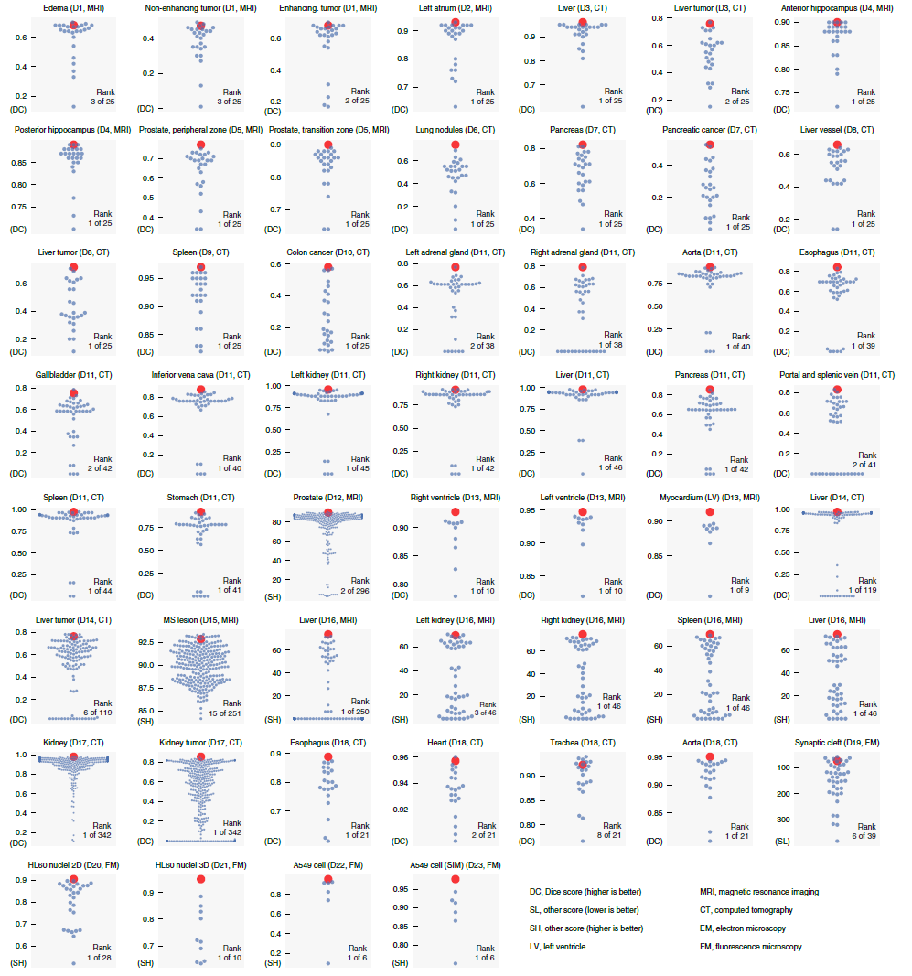
Introduction
Medical Image Segmentation is difficult because of the vast diversity of modalities, each of which requires a specialized pipeline for data pre-processing and training.
nnU-Net (“no new U-Net”) seeks to establish a standardized pipeline for the medical image segmentation process.

Slide 3
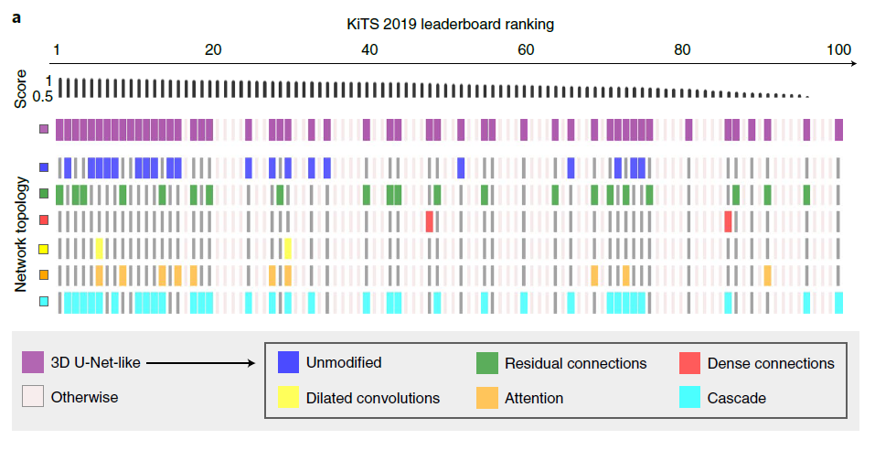
Problem Statement
Analysis of challenge leaderboard entries shows that using superficially similar methods and model architectures can lead to vastly different results due to implementation details.
Moreover, no single method stands out as being necessary for high scores (except deep learning).

Slide 4
AudoML Paradigms
Data-Driven
Concentrate on data and pipelines
Covers a part of the pipelines
Architecture
Data Augmentation
Challenges
Amplifies the number of training cases
Increases computing resources
Requiring configuration by the experimenters
nnUnet solution
Fixed configuration independent from problem and datasets
Formulate heuristic rules depending on the case
Post-processing decisions

Slide 5
Architecture Design decision
U-Net like architectures enable state of the art segmentation when the pipeline is well-configured.
Sophisticated architectural variations are not required to achieve state of the art performance.
Architecture only use plain convolutions, instance normalization and Leaky non-linearities
They use two computational blocks per resolution stage in both encoder and decoder.
Downsampling is done with strided convolutions,upsampling is done with convolutions transposed.
Predicting which configurations should be trained on which dataset is a future research direction.
Notes:
The order of operations in each computational block is conv - instance norm- leaky ReLU.
The convolution of the first block of the new resolution has stride >1,
nnU-Net is configured to utilize 11GB of GPU memory. This requirement is, based on their experience
there is no conceivable difference in performance between ReLU and leaky ReLU nonlinearities. The performance drops,however, when replacing convolution transpose in the decoder with trilinear upsampling and when removing the auxiliary loss layers.

Slide 6
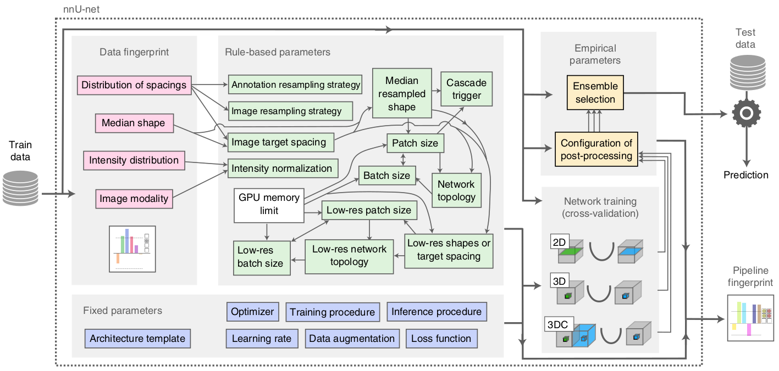
Architecture

Slide 7
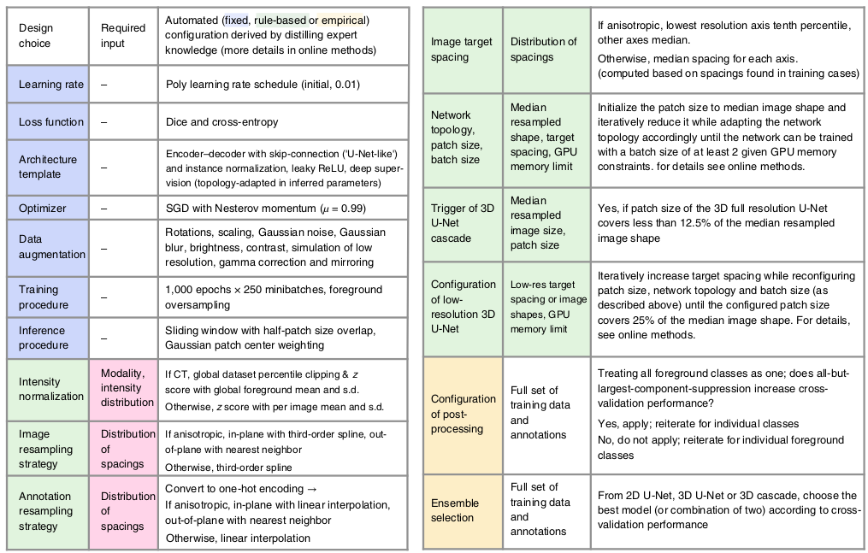
Method
nnU-Net divides hyper-parameters into 3 types:
Fixed configurations
Rule-Based configurations
Empirical Configurations
In all cases, validation set performance does not affect training time, unlike in AutoML.

Slide 8
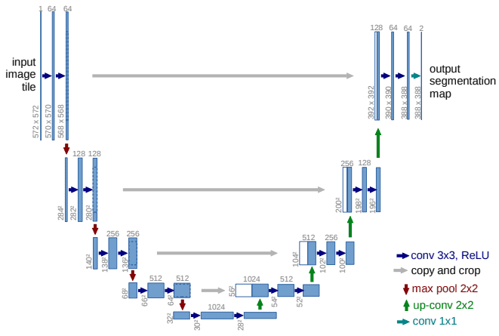
Fixed Configurations
Parameters that don’t need to change when we are moving from one dataset to another:
Model architecture (U-Net), hence the name “no new U-Net”.
The Encoder, Decoder with skip-connection don’t have to be changed
Learning Rate: 0.01

Slide 9
Fixed Configurations
Optimizer (SGD with Nesterov momentum 0.9).
Training procedure (250k iterations with 5-fold cross-validation and foreground over-sampling).
Inference procedure (sliding window with Gaussian importance weighting).

Slide 10
Rule-Based Configurations
Image Intensity Normalization (Use HU if CT, else use z normalization).
Image Resampling Strategy (If anisotropic, use cubic spline if ratio is within 3, else use nearest neighbor interpolation).
Image Spacing (lowest 10th percentile if anisotropic, else median).
Use 3D cascade (if image is too large).
Model pooling depth (reduce anisotropic side until less than 3, pool until side length becomes 4).
Mini-batch size (largest mini-batch that fits within 11 GB during training).

Slide 11
Rule-Based Model Configurations
Network Topology, Patch Size, and Batch Size are configured at the start of training.
Networks are expected to give approximate GPU memory usage expectations.
Patch size is given high priority as large patch size is necessary for segmentation.
Network topology is designed to pool until side length is 4 and anisotropic degree is within 3.
Batch size is set to be lower than 5% of total data.

Slide 12
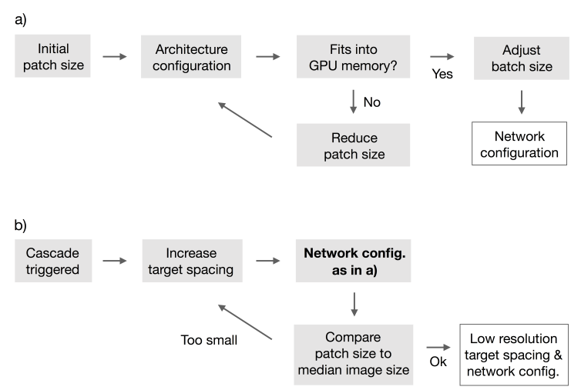
Workflow for network architecture configuration
The configuration of a U-Net architecture given an input patch size and corresponding voxel spacing, due to discontinuities in GPU memory consumption.
The input patch size of the 3D lowres U-Net must cover at least 1/4 of the median shape of the resampled training cases to ensure sufficient contextual information.
Notes:
Higher resolution axes are downsampled first, resulting in a potentially different aspect ratio of the data relative to the full resolution data. Due to the patch size following this aspect ratio, the network architecture of the low resolution U-Net may differ from the full resolution U-Net. This requires reconfiguration of the network architecture as depicted in a) for each iteration. All computations are based on memory consumption estimates resulting in fast computation times (sub 1s for configuring all network architectures.

Slide 13
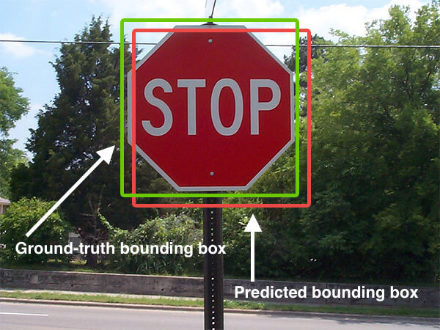
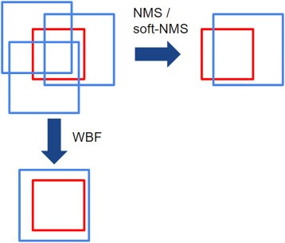
Evaluating the performance on the validation set
IoU
area of overlap / area of union
NMS
uses the objectiveness score (confidence) and IoU
WBC (WBF)
combines all of the segments
Notes:
Evaluating the performance on the validation set

Slide 14
Empirical Parameters
Model Selection
nnU-Net generate multiple models
2D U-Net
3D U-Net
3D Cascade
5-fold cross-validation to assess accuracy/performance
Pick the best performing model, or a combination of them
Post-Processing
The medical image contains only one instance of the target
Connected component analysis is useful here

Slide 15
Post-Processing
Connected-component based
Removing all but the largest connected component
nnU-Net automatically benchmarks the effect of suppressing smaller components on the cross-validation results:
Treat all foreground classes as one component. If suppression of all but the largest region improves the average foreground Dice coefficient and does not reduce the Dice coefficient for any of the classes, this procedure is selected as the first post-processing step.
Decides whether the same procedure should be performed for individual classes.

Slide 16
Comments
Training time and memory requirements do not depend on performance on validation metrics.
No pre-trained networks are necessary as inputs.
No 2.5D, which may be effective in some anisotropic tasks. More robust to anisotropic data while not abandoning the information from the anisotropic direction.
No analysis on the effect of label quality. For example, what is the effect of nnUNet when comparing clean and noisy labels. Is it robust to noisy labels? What attributes are important for learning with sparsely labeled data

Slide 17
Results
First place in 33 of 53 challenges with no modifications.
Maintains a high rank in all challenges submitted, though in some cases, modifications to the original nnUNet was necessary (e.g., 2020 COVID19 segmentation challenge).
nnU-Net is the baseline for most new medical segmentation challenges

Slide 18
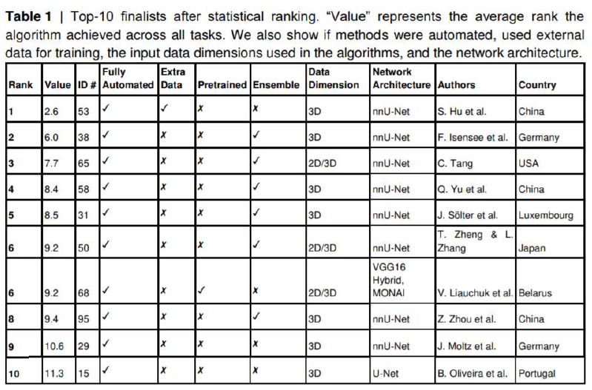
Results
Results for COVID19 segmentation challenge in 2020.
nnUNet features in the top-tier of nearly all medical segmentation challenges.
First place used nnUNet to pseudolabel more data for additional training with nnU-Net

Slide 19
THANKS!
Any questions?

Slide 20
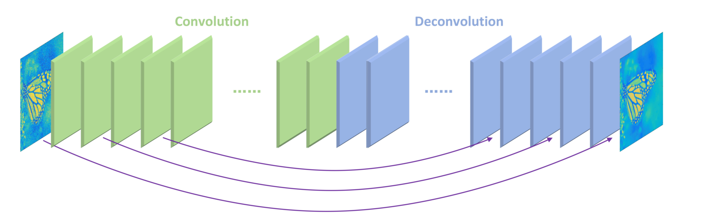
Skip-Connection (OR Shortcut Connections)
Skips some of the layers in the neural network and feeds the output of one layer as the input to the next layers

Slide 21
Data Augmentation
Rotation and Scaling. Scaling and rotation are applied together for improved speed of computation. This approach reduces the amount of required data interpolations to one.
Gaussian Noise. Zero centered additive Gaussian noise is added to each voxel in the sample independently
Gaussian Blur. Blurring is applied with a probability of 0.2 per sample.
Brightness. Voxel intensities are multiplied by x ∼ U (0.7, 1.3) with a probability of 0.15
Contrast. Voxel intensities are multiplied by x ∼ U (0.65, 1.5) with a probability of 0.15.
Simulation of low resolution. This augmentation is applied with a probability of 0.25 persample and 0.5 per associated modality.
Gamma augmentation. This augmentation is applied with a probability of 0.15.Mirroring. All patches are mirrored with a probability of 0.5 along all axes.
Mirroring. All patches are mirrored with a probability of 0.5 along all axes.

Slide 22
Inferred Parameters
Dynamic Network adaptation
Needs to be adapted to the size and spacing of the input patches seen during training
perform downsampling until the feature maps are relatively small (minimum is 4 × 4(×4))
Number of convolutional layers in the network (excluding segmentation layers) is (5 ∗ k + 2) where k is the number of downsampling operations
(5 per downsampling stems from 2 convs inthe encoder, 2 in the decoder plus the convolution transpose.
Additional loss functions are applied to all but the two lowest resolutions of the decoder to inject gradients deep into the network.
For anisotropic data, pooling is first exclusively performed in-plane until the resolution
matches between the axes
Configuration of the input patch size
Batch size
Target spacing and resampling
Intensity normalization

Slide 23
Training Scheme
All trainings run for a fixed length of 1000 epochs, where each epoch is defined as 250 training iterations
As for the optimizer, stochastic gradient descent with a high initial learning rate (0.01) and a large nesterov momentum (0.99) empirically provided the best results
Data augmentation is essential to achieve state of the art performance. It is important to run the augmentations on the fly and with associated probabilities to obtain a never ending stream of unique examples
Data in the biomedical domain suffers from class imbalance. Rare classes could end up being ignored because they are underrepresented during training. Oversampling foreground regions addresses this issue reliably.
combining
the Dice loss with a cross-entropy loss improved training stability and segmentation accuracy. Therefore, the two loss terms are simply averaged.
Notes:
The Dice loss function is well suited to address the class imbalance, but comes with its own drawbacks. Dice loss optimizes the evaluation metric directly, but due to the patch based training, in practice merely approximates it.

